Slide 1

Normalisation
Week 4 - Lab 2 Preparation & Guidelines
Dr Farshid Keivanian

Slide 2
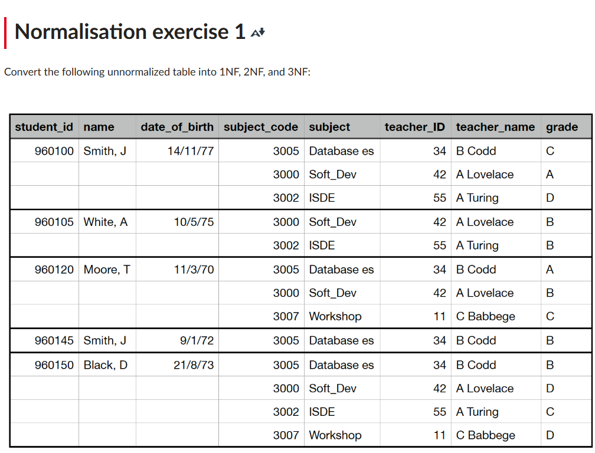
Week 4 – Lab 2
Navigate Canvas >> Modules >> Week 4: Lab 2
2 | Faculty of Business and Law | Peter Faber Business School

Slide 3
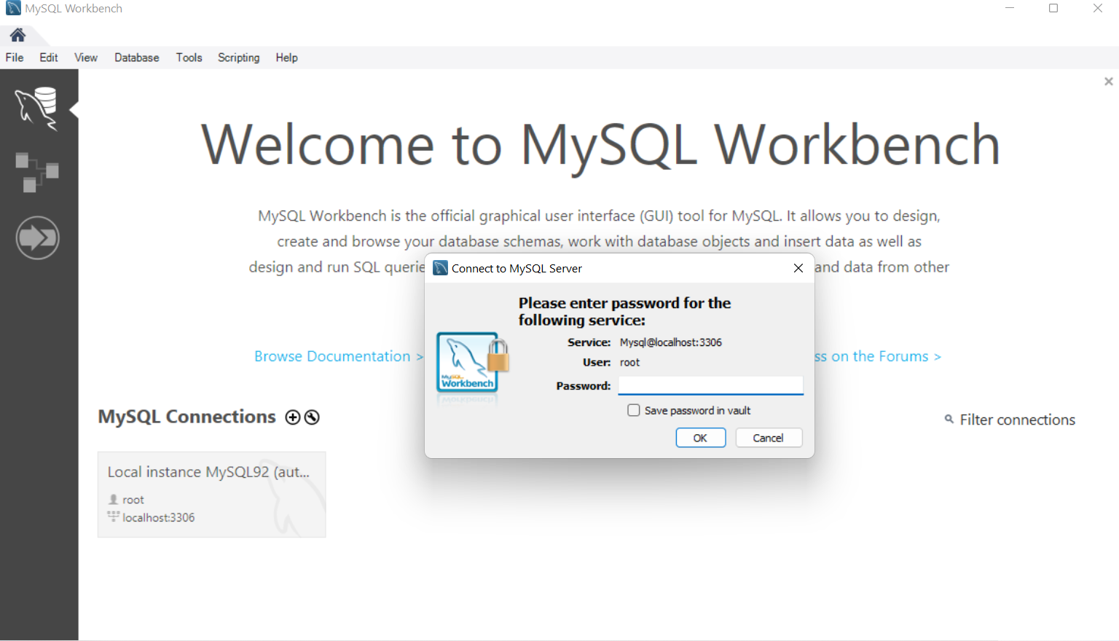
Week 4 – Lab 2
2 | Faculty of Business and Law | Peter Faber Business School

Slide 4
Week 4 – Lab 2
Introduction to Normalization
Welcome to today’s session on Database Normalization! By the end of this lecture, you will:
Understand the importance of normalization.
Learn how to apply 1NF, 2NF, and 3NF.
Implement normalization in MySQL Workbench.
2 | Faculty of Business and Law | Peter Faber Business School

Slide 5
Week 4 – Lab 2
Why Normalize a Database?
Think about a messy room—everything scattered around. Finding something takes forever! The same happens with databases when they contain redundant and unstructured data. Normalization helps by:
Eliminating duplicate data.
Reducing storage space.
Enhancing data integrity and consistency.
Improving query efficiency.
2 | Faculty of Business and Law | Peter Faber Business School

Slide 6
Week 4 – Lab 2
Understanding Unnormalized Form (UNF)
Problem: Our table contains repeating groups—a student’s subjects are listed in multiple columns instead of separate rows.
Example (Unnormalized Table):
student_id | name | date_of_birth | subject_code | subject | teacher_ID | teacher_name | grade 960100 | Smith, J | 14/11/77 | 3005, 3000 | DB, SoftDev| 34, 42 | B Codd, A Lov | C, A
Issue: Multiple values in a single cell violate 1NF
2 | Faculty of Business and Law | Peter Faber Business School

Slide 7
Week 4 – Lab 2
Step 1: Convert to First Normal Form (1NF)
Solution: Ensure each column has atomic values (one value per cell).
1NF Table:
student_id | name | date_of_birth | subject_code | subject | teacher_ID | teacher_name | grade 960100 | Smith, J | 14/11/77 | 3005 | Database | 34 | B Codd | C 960100 | Smith, J | 14/11/77 | 3000 | SoftDev | 42 | A Lovelace | A
2 | Faculty of Business and Law | Peter Faber Business School

Slide 8
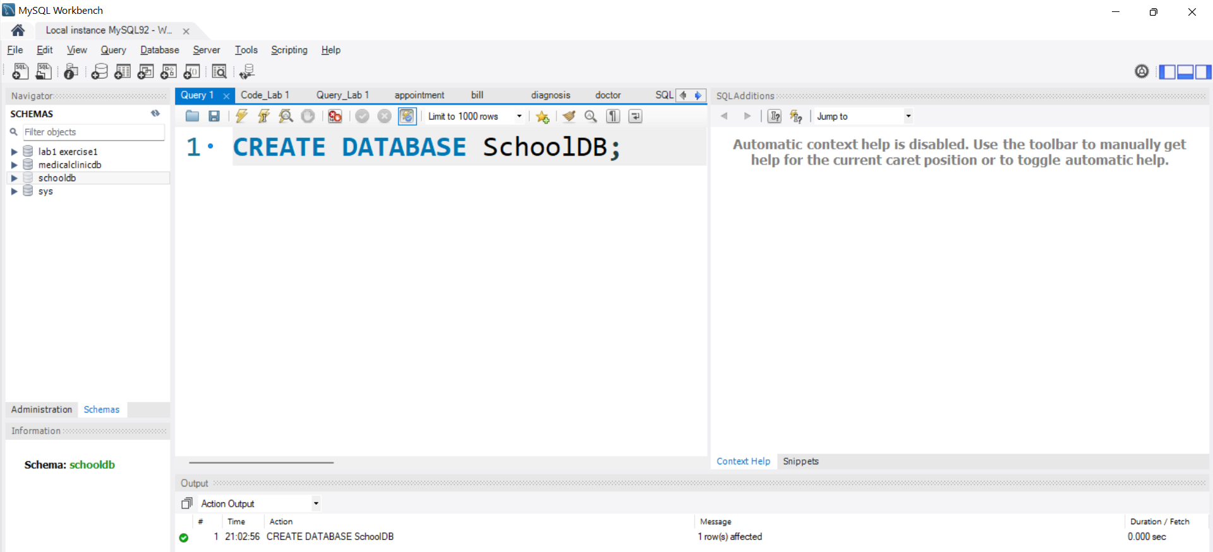
Week 4 – Lab 2
Action in MySQL Workbench:
Open MySQL Workbench.
Create a new database (CREATE DATABASE SchoolDB;);
student_id | name | date_of_birth | subject_code | subject | teacher_ID | teacher_name | grade 960100 | Smith, J | 14/11/77 | 3005 | Database | 34 | B Codd | C 960100 | Smith, J | 14/11/77 | 3000 | SoftDev | 42 | A Lovelace | A
2 | Faculty of Business and Law | Peter Faber Business School

Slide 9
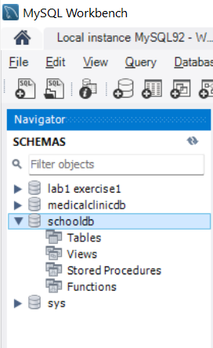
How to Verify If the Database Exists
To check if SchoolDB was created, follow these steps:
In MySQL Workbench, look at the Navigator (left panel).
Click on Schemas (You may need to refresh by clicking the refresh icon).
You should see SchoolDB listed.
2 | Faculty of Business and Law | Peter Faber Business School

Slide 10
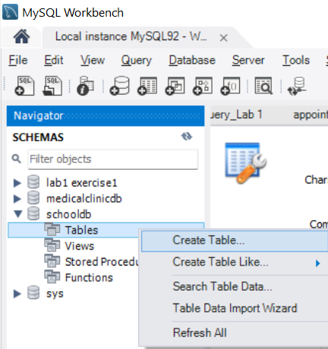
Week 4 – Lab 2
Create the StudentGrades table:
student_id | name | date_of_birth | subject_code | subject | teacher_ID | teacher_name | grade 960100 | Smith, J | 14/11/77 | 3005 | Database | 34 | B Codd | C 960100 | Smith, J | 14/11/77 | 3000 | SoftDev | 42 | A Lovelace | A
Using MySQL Workbench GUI (No Code)
Click on the SchoolDB database in the Navigator (left panel) under Schemas.
Right-click on "Tables" → Select "Create Table".
In the Table Name field, enter the name of above table (Students).
2 | Faculty of Business and Law | Peter Faber Business School

Slide 11
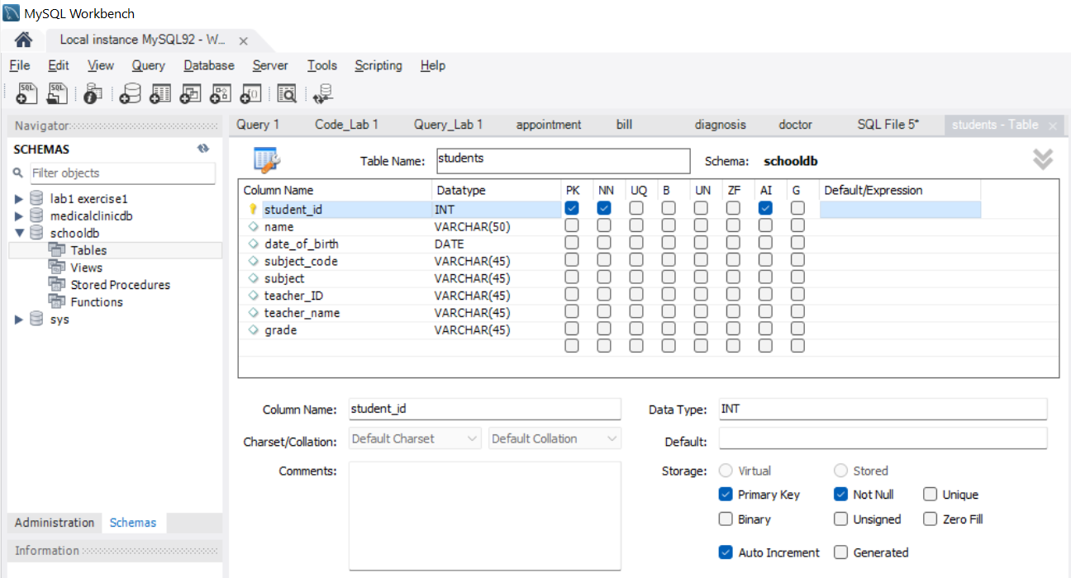
Under the Columns section:
Add column names (e.g., student_id, name, date_of_birth, subject_code, subject, teacher_ID, teacher_name, grade).
Select the appropriate data type (INT, VARCHAR(50), DATE, etc.).
2 | Faculty of Business and Law | Peter Faber Business School

Slide 12
Set student_id as Primary Key (PK) by checking the PK box. Check the NN (Not Null) box to ensure it cannot have NULL values. Since student_id is the Primary Key, it must always have a value. If you want student_id to be assigned automatically, check the AI (Auto Increment) box.
2 | Faculty of Business and Law | Peter Faber Business School

Slide 13
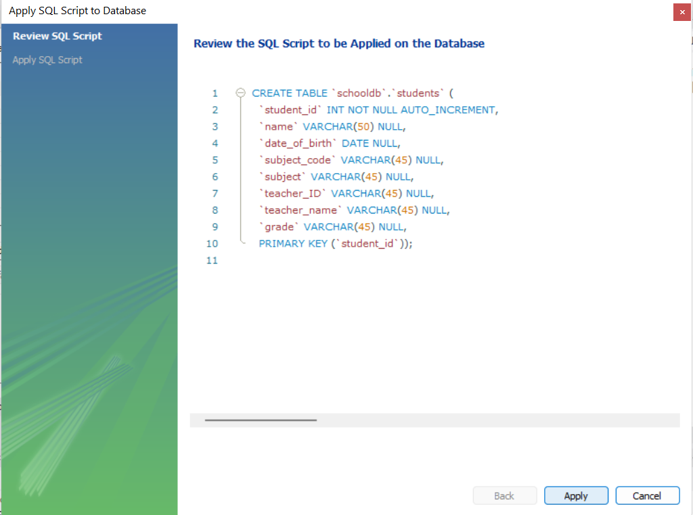
5. Click Apply, then Finish
2 | Faculty of Business and Law | Peter Faber Business School

Slide 14
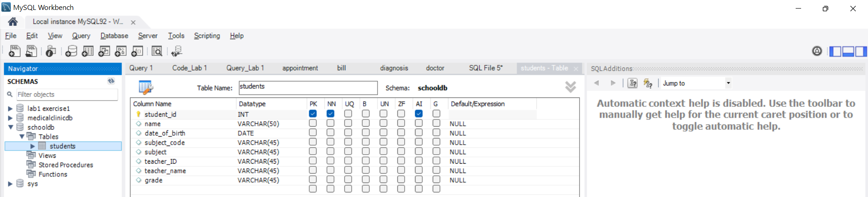
Once finished, click Refresh in the Navigator panel and check if the students table appears.
2 | Faculty of Business and Law | Peter Faber Business School

Slide 15
Week 4 – Lab 2
Now that we have created the Students table with columns, let's go step by step to populate the table with the given data (from the 2nd screenshot) and convert it to First Normal Form (1NF).
2 | Faculty of Business and Law | Peter Faber Business School

Slide 16
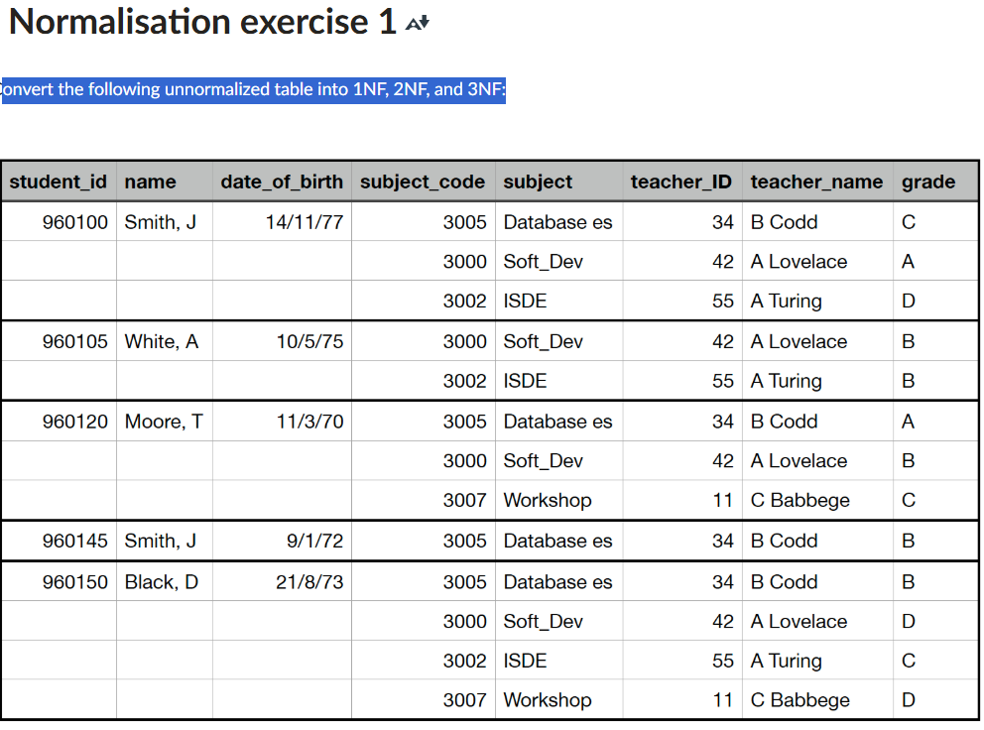
Step 1: Understanding the Issue in the Given Table (UNF)
The attached table (UNF) contains repeating groups (multiple subjects per student in a single row).
This violates 1NF, which requires:
Atomicity (each column should contain only one value).
Uniqueness (each row should be uniquely identifiable).
The current table structure in MySQL Workbench has all attributes in a single table, which violates 1NF.
2 | Faculty of Business and Law | Peter Faber Business School

Slide 17
This violates 1NF because multiple values exist in single cells.
Step 2: Fix Table Structure (1NF-Compliant)
To achieve 1NF, we must:
Create a separate table (StudentGrades) to store student-subject-grade details.
Remove repeating groups from the Students table.
2 | Faculty of Business and Law | Peter Faber Business School

Slide 18
Step 3: Modify the Table Structure in MySQL Workbench
Students Table cannot be executed
USE SchoolDB;
INSERT INTO Students (student_id, name, date_of_birth, subject_code, subject, teacher_ID, teacher_name, grade)
VALUES
(960100, 'Smith, J', '1977-11-14', 3005, 'Database es', 34, 'B Codd', 'C'),
(960100, 'Smith, J', '1977-11-14', 3000, 'Soft_Dev', 42, 'A Lovelace', 'A'),
(960100, 'Smith, J', '1977-11-14', 3002, 'ISDE', 55, 'A Turing', 'D'),
(960105, 'White, A', '1975-05-10', 3000, 'Soft_Dev', 42, 'A Lovelace', 'B'),
(960105, 'White, A', '1975-05-10', 3002, 'ISDE', 55, 'A Turing', 'B'),
(960120, 'Moore, T', '1970-03-11', 3005, 'Database es', 34, 'B Codd', 'A'),
(960120, 'Moore, T', '1970-03-11', 3000, 'Soft_Dev', 42, 'A Lovelace', 'B'),
(960120, 'Moore, T', '1970-03-11', 3007, 'Workshop', 11, 'C Babbage', 'C'),
(960145, 'Smith, J', '1972-01-09', 3005, 'Database es', 34, 'B Codd', 'B'),
(960150, 'Black, D', '1973-08-21', 3005, 'Database es', 34, 'B Codd', 'B'),
(960150, 'Black, D', '1973-08-21', 3000, 'Soft_Dev', 42, 'A Lovelace', 'D'),
(960150, 'Black, D', '1973-08-21', 3002, 'ISDE', 55, 'A Turing', 'C'),
(960150, 'Black, D', '1973-08-21', 3007, 'Workshop', 11, 'C Babbage', 'D');
2 | Faculty of Business and Law | Peter Faber Business School

Slide 19
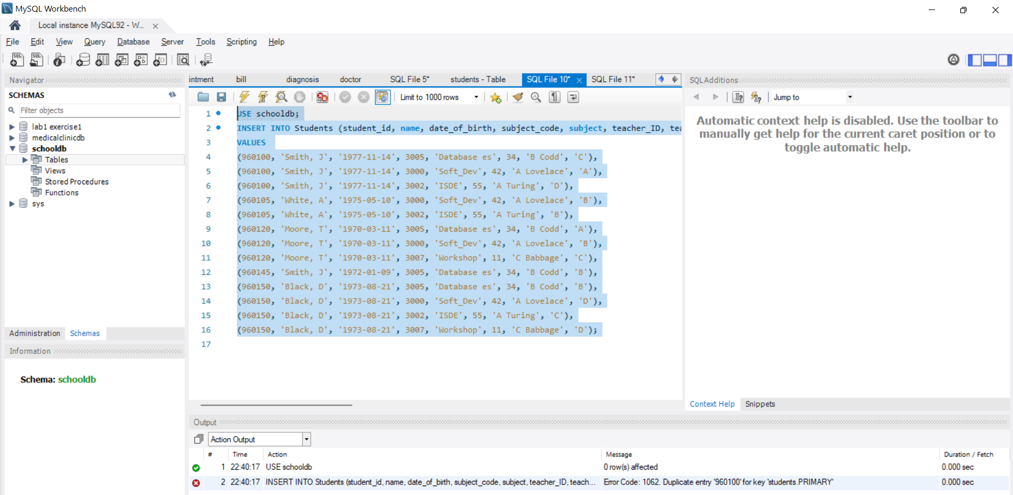
Step 3: Modify the Table Structure in MySQL Workbench
It shows an error → Duplicate entry 960100 for key ‘students.PRIMAY’
2 | Faculty of Business and Law | Peter Faber Business School

Slide 20
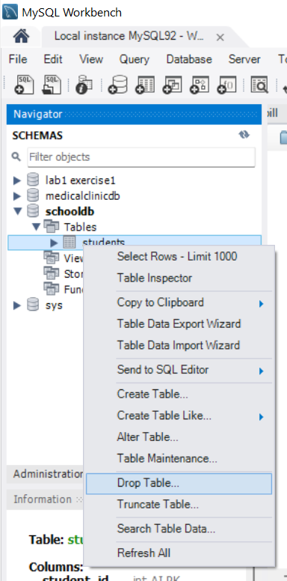
Step 3: Modify the Table Structure in MySQL Workbench
We must drop the current Table, and Create the Correct students Table: This table should contain only student details:
2 | Faculty of Business and Law | Peter Faber Business School

Slide 21
Step 3: Modify the Table Structure in MySQL Workbench
New Query (+SQL)
Execute the following Query
CREATE TABLE Students (
student_id INT NOT NULL PRIMARY KEY,
name VARCHAR(50) NOT NULL,
date_of_birth DATE NOT NULL
);
2 | Faculty of Business and Law | Peter Faber Business School

Slide 22
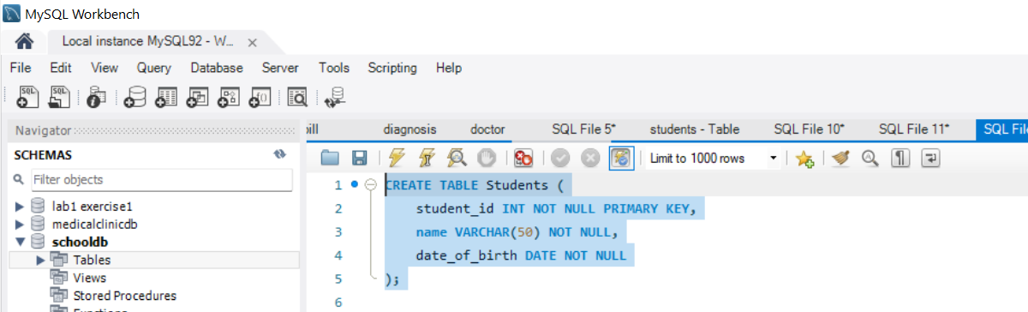
Step 3: Modify the Table Structure in MySQL Workbench
Executed
2 | Faculty of Business and Law | Peter Faber Business School

Slide 23
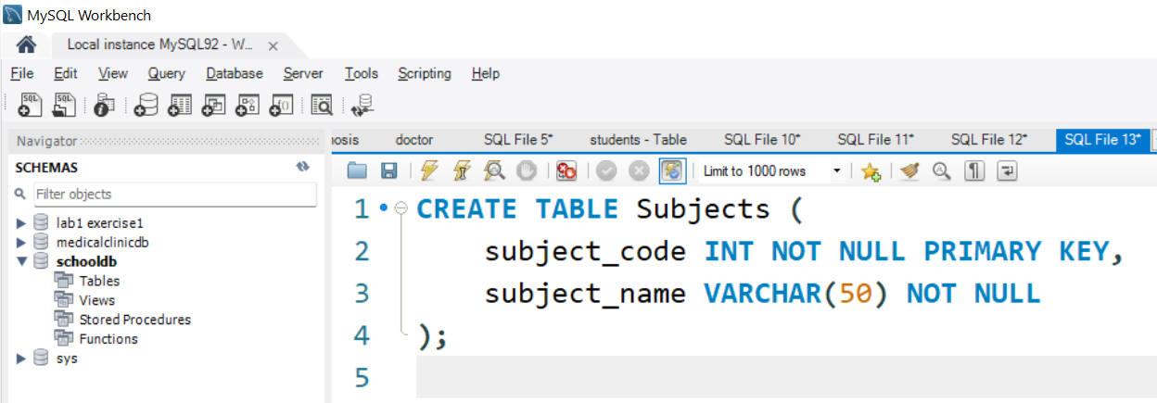
Step 3: Modify the Table Structure in MySQL Workbench
Create Subject Table: Each subject is stored only once (removes redundancy)
New Query (+SQL)
Execute it
2 | Faculty of Business and Law | Peter Faber Business School

Slide 24
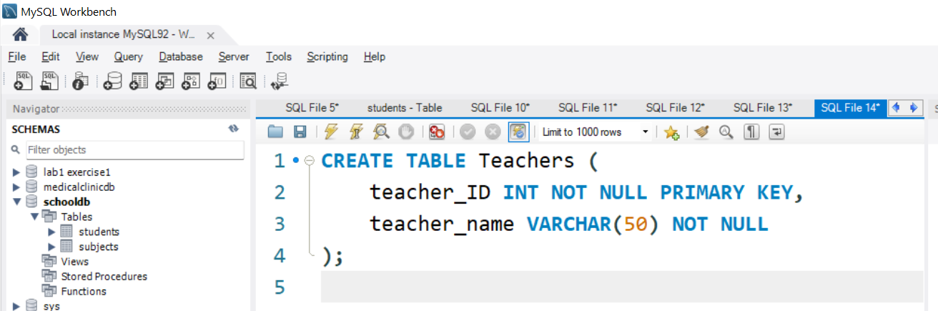
Step 3: Modify the Table Structure in MySQL Workbench
Create Teachers Table
Each Teacher appears once, ensuring atomicity:
New Query (+SQL )
Execute it
2 | Faculty of Business and Law | Peter Faber Business School

Slide 25
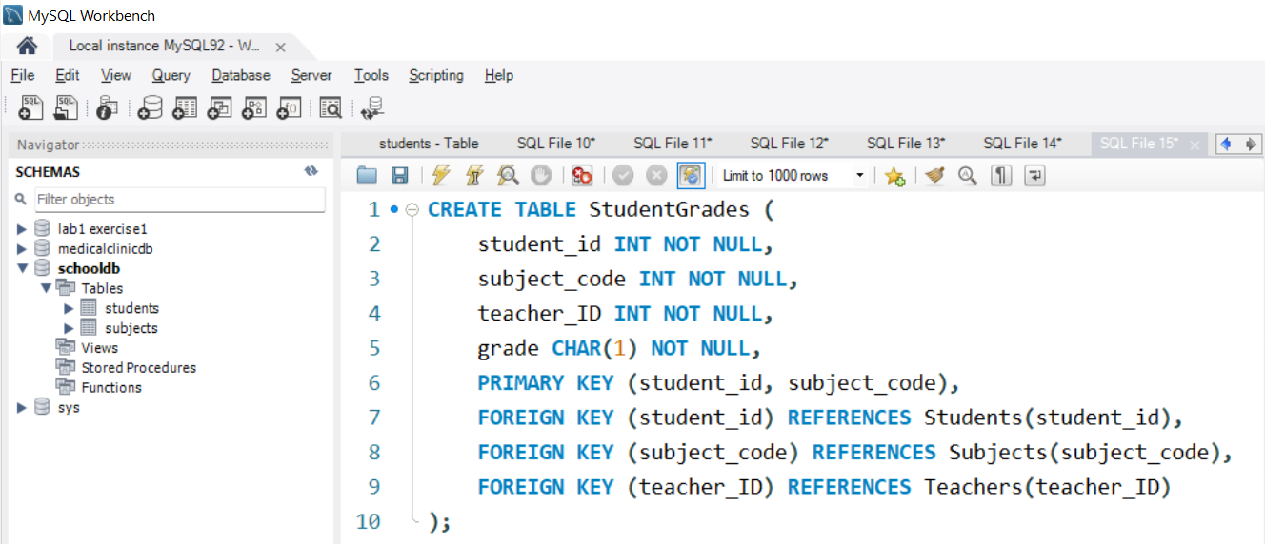
Step 3: Modify the Table Structure in MySQL Workbench
Create StudentGrades Table
This stores subject enrollment details for each student:
New Query (+SQL )
Execute it
2 | Faculty of Business and Law | Peter Faber Business School

Slide 26
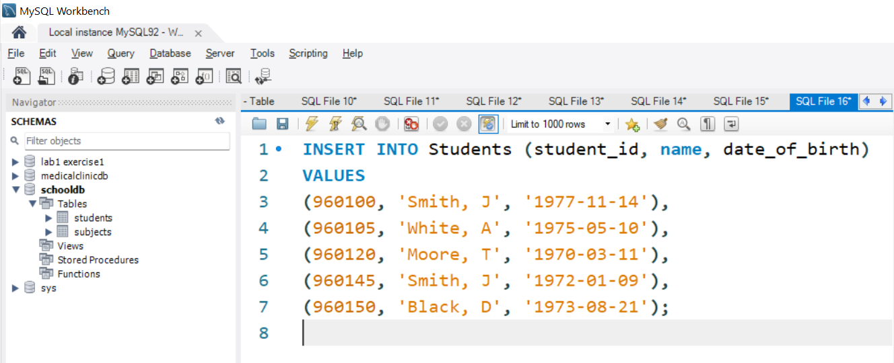
Step 3: Modify the Table Structure in MySQL Workbench
Step 4: Insert Data (1NF-Compliant Format)
Now, insert each student once into Students:
New Query (+SQL)
Execute it
2 | Faculty of Business and Law | Peter Faber Business School

Slide 27
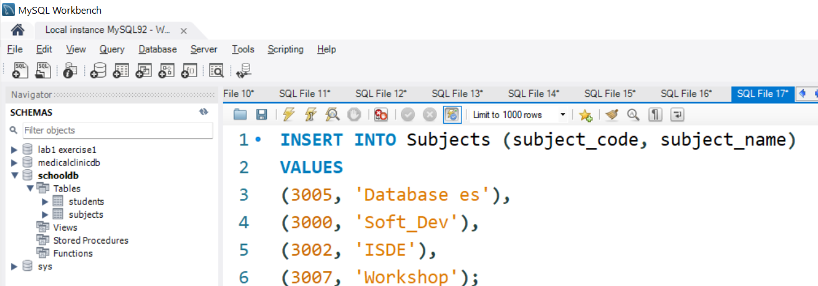
Step 3: Modify the Table Structure in MySQL Workbench
Then, insert each subject once into Subjects:
New Query (+SQL)
Execute it
2 | Faculty of Business and Law | Peter Faber Business School

Slide 28
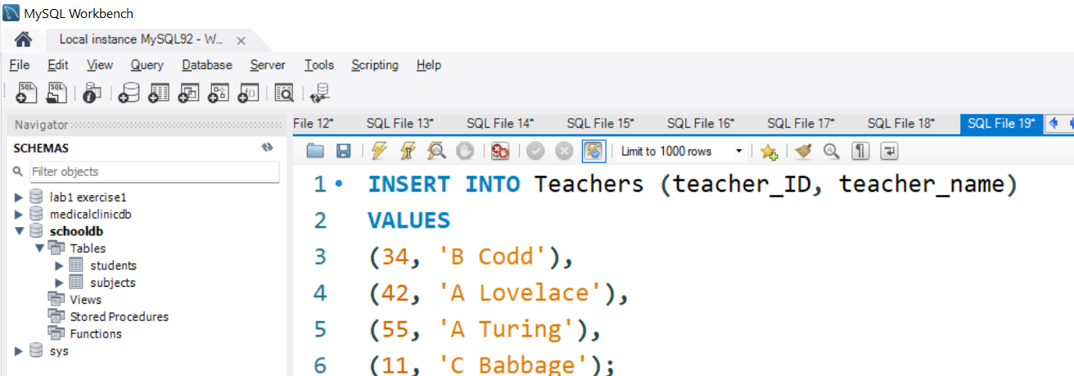
Step 3: Modify the Table Structure in MySQL Workbench
Then, insert each teacher once into Teachers:
New Query (+SQL)
Execute it
2 | Faculty of Business and Law | Peter Faber Business School

Slide 29
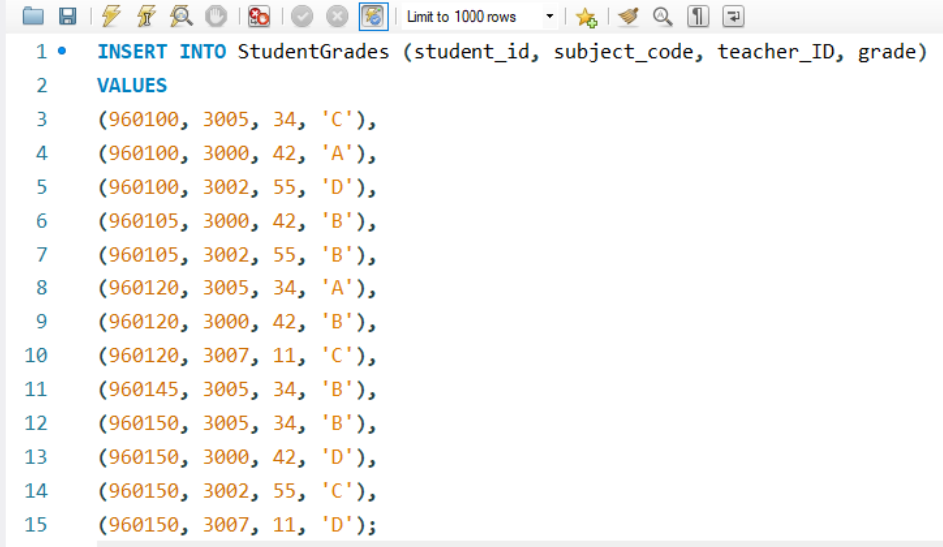
Step 3: Modify the Table Structure in MySQL Workbench
Step 5: Insert Normalized Data into StudentGrades
Now, each student has one row per subject:
New Query (+SQL)
Execute it
2 | Faculty of Business and Law | Peter Faber Business School

Slide 30
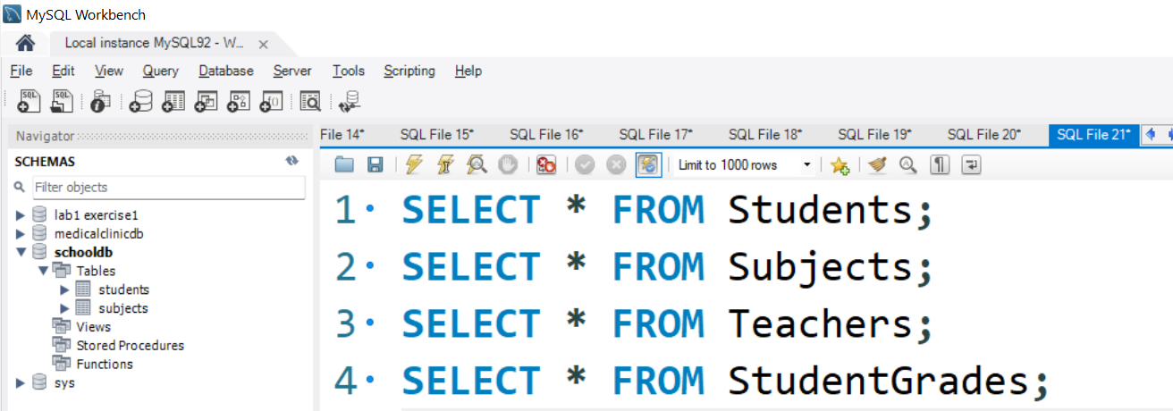
Step 3: Modify the Table Structure in MySQL Workbench
Step 6: Verify the 1NF Transformation
After inserting, run:
New Query (+SQL)
Execute it
2 | Faculty of Business and Law | Peter Faber Business School

Slide 31
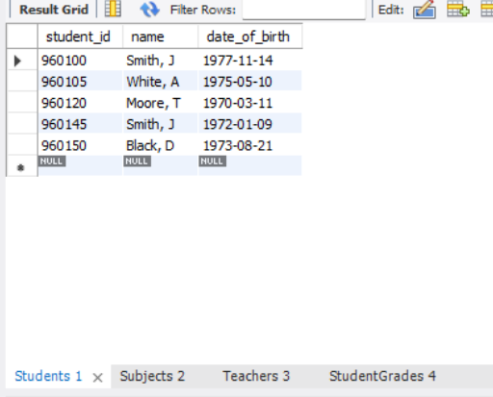
Step 3: Modify the Table Structure in MySQL Workbench
If each subject, teacher, and grade appears in a separate row, your data is now in 1NF!
2 | Faculty of Business and Law | Peter Faber Business School

Slide 32
Step 3: Modify the Table Structure in MySQL Workbench
Summary: What You Achieved
1NF Applied → Each value is atomic (no multi-values).
Proper Table Structure → Data is separated correctly.
No Duplicates or Redundancy → Ensures data integrity.
2 | Faculty of Business and Law | Peter Faber Business School

Slide 33
Converting Data from 1NF to 2NF in MySQL
Now that our data is in First Normal Form (1NF), we need to convert it to Second Normal Form (2NF
2 | Faculty of Business and Law | Peter Faber Business School

Slide 34
Converting Data from 1NF to 2NF in MySQL
Why Convert to 2NF?
Even though 1NF removes repeating groups, it still has partial dependencies.
2NF Rule:
Must be in 1NF
2 | Faculty of Business and Law | Peter Faber Business School

Slide 35
No Partial Dependencies:
A partial dependency happens when a non-primary key attribute depends on part of a composite primary key instead of the whole primary key.
Example Problem:
In the StudentGrades table, the student's name and date_of_birth depend only on student_id, not subject_code.
Similarly, teacher_name depends only on teacher_ID, not student_id + subject_code.
Solution: Break the table into smaller, independent tables.
2 | Faculty of Business and Law | Peter Faber Business School

Slide 36
Step 1: Identify Partial Dependencies in 1NF
In 1NF, we have:
student_id | name | date_of_birth | subject_code | subject | teacher_ID | teacher_name | grade
960100 | Smith, J | 1977-11-14 | 3005 | Database es | 34 | B Codd | C
960100 | Smith, J | 1977-11-14 | 3000 | Soft_Dev | 42 | A Lovelace | A
2 | Faculty of Business and Law | Peter Faber Business School

Slide 37
student_id | name | date_of_birth | subject_code | subject | teacher_ID | teacher_name | grade
960100 | Smith, J | 1977-11-14 | 3005 | Database es | 34 | B Codd | C
960100 | Smith, J | 1977-11-14 | 3000 | Soft_Dev | 42 | A Lovelace | A
Issues:
Student details (name, date_of_birth) should only depend on student_id.
Subject details (subject name) should only depend on subject_code.
Teacher details (teacher name) should only depend on teacher_ID.
Fix: Create separate tables for Students, Subjects, and Teachers to remove partial dependencies.
2 | Faculty of Business and Law | Peter Faber Business School

Slide 38
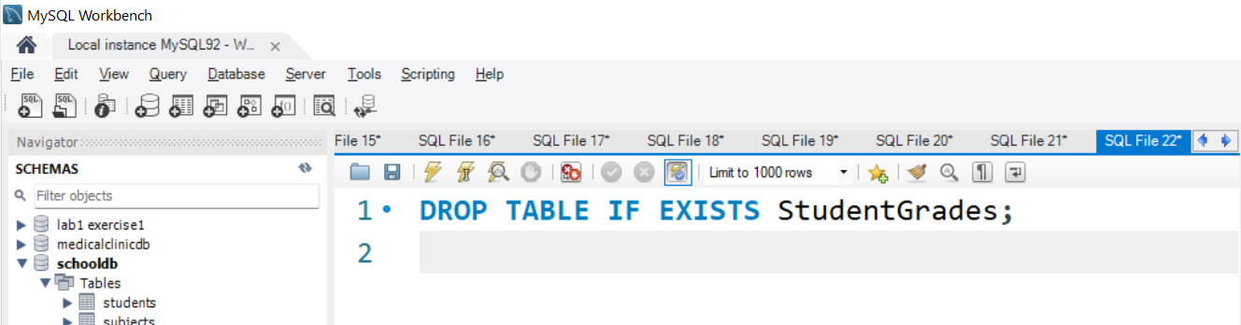
Step 2: Modify the Table Structure for 2NF
To convert to 2NF, we must separate data into smaller tables where each non-key column fully depends on the primary key.
Drop the Incorrect Table (if needed)
If your current StudentGrades table contains partial dependencies, delete it before creating a new one:
New Query (+SQL)
Execute it
2 | Faculty of Business and Law | Peter Faber Business School

Slide 39
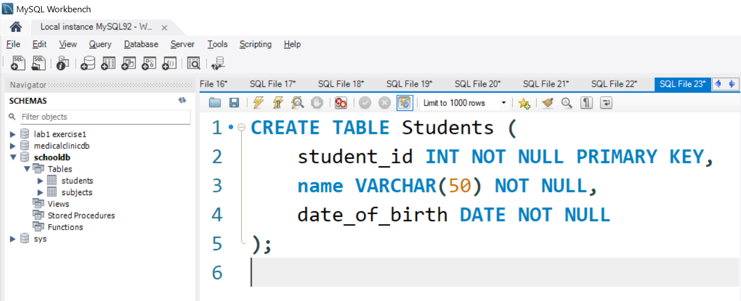
B. Create the Students Table (Only Student Details)
Each student is stored once to remove redundancy.
New Query (+SQL)
Execute it
2 | Faculty of Business and Law | Peter Faber Business School

Slide 40
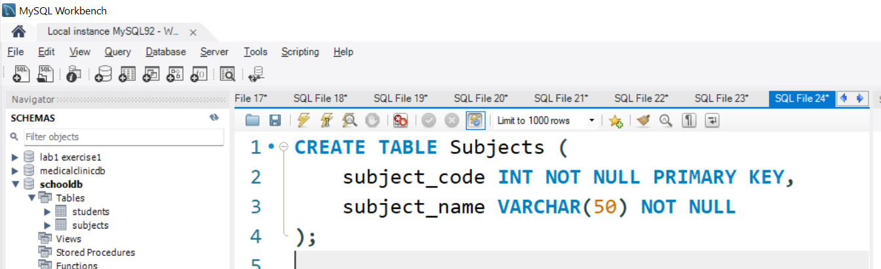
C. Create the Subjects Table (Only Subject Details)
Each subject is stored once and only depends on subject_code.
New Query (+SQL)
Execute it
2 | Faculty of Business and Law | Peter Faber Business School

Slide 41
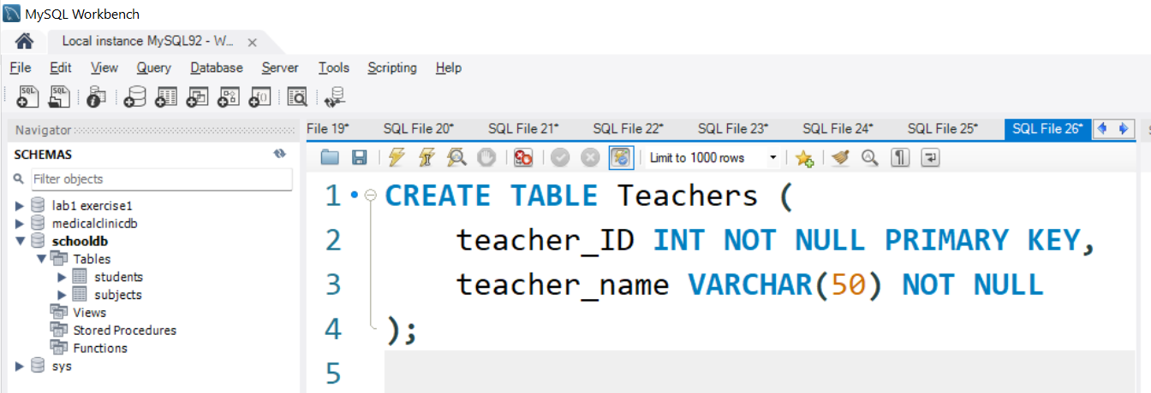
D. Create the Teachers Table (Only Teacher Details)
Each teacher appears only once.
New Query (+SQL)
Execute it
2 | Faculty of Business and Law | Peter Faber Business School

Slide 42
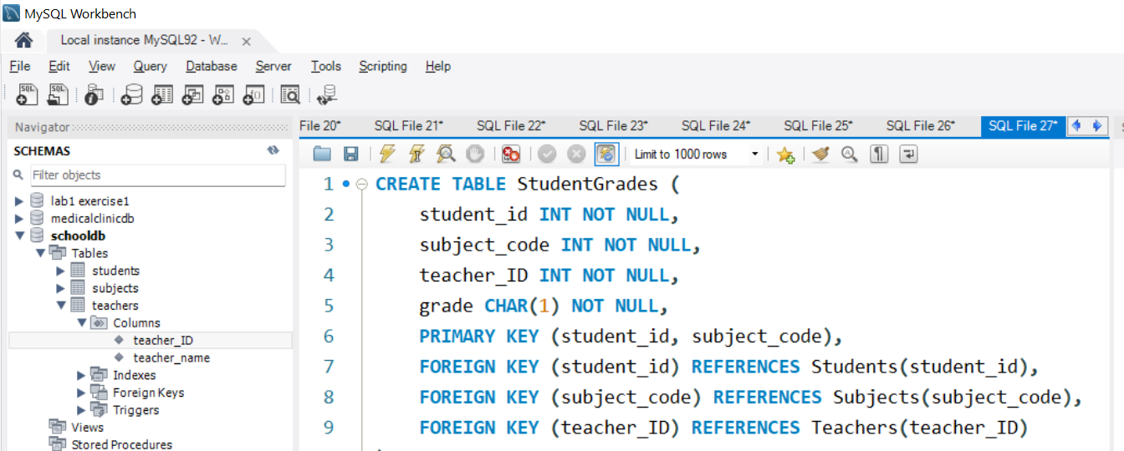
E. Create the StudentGrades Table (Only Relationships)
Only contains relationships between student_id, subject_code, teacher_ID, and grade.
New Query (+SQL)
Execute it
2 | Faculty of Business and Law | Peter Faber Business School

Slide 43
E. Create the StudentGrades Table (Only Relationships)
Why?
This ensures no partial dependencies.
grade now fully depends on both student_id and subject_code.
2 | Faculty of Business and Law | Peter Faber Business School

Slide 44
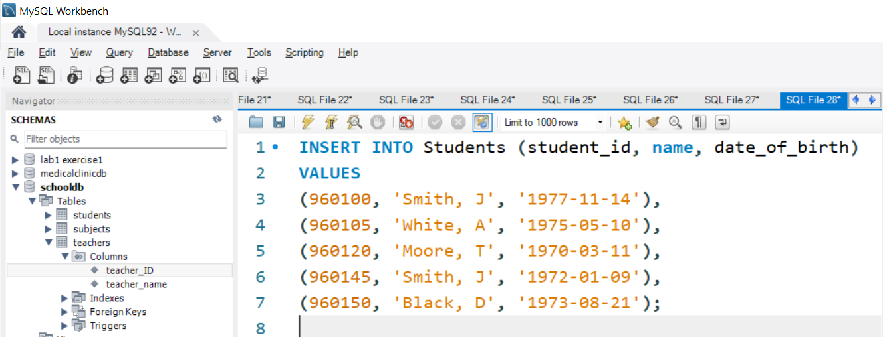
Step 3: Insert 2NF-Compliant Data
Now, insert each entity separately.
A. Insert Students (No Subject or Teacher Info)
New Query (+SQL)
Execute it
2 | Faculty of Business and Law | Peter Faber Business School

Slide 45
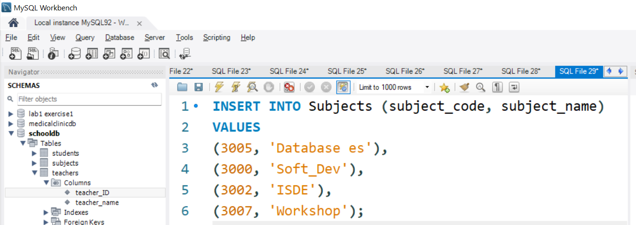
B. Insert Subjects (No Student or Teacher Info)
New Query (+SQL)
Execute it
2 | Faculty of Business and Law | Peter Faber Business School

Slide 46
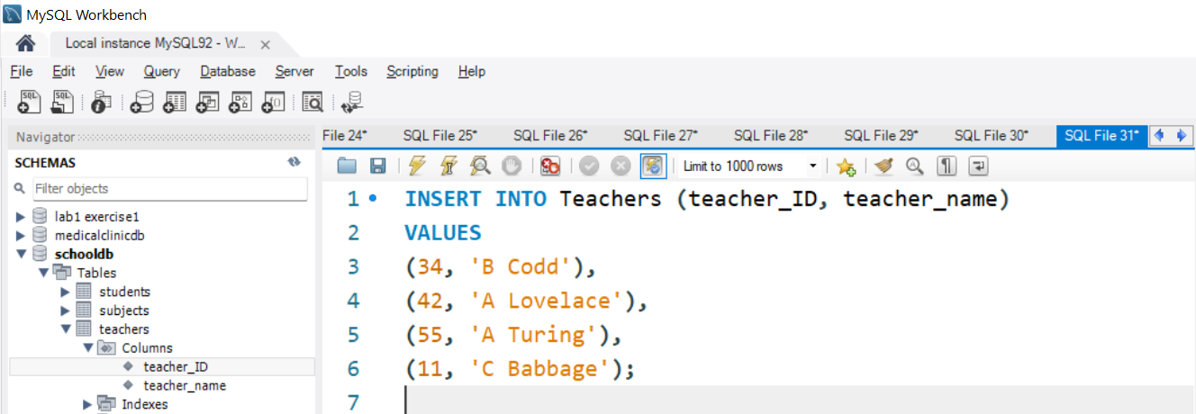
C. Insert Teachers (No Student or Subject Info)
New Query (+SQL)
Execute it
2 | Faculty of Business and Law | Peter Faber Business School

Slide 47
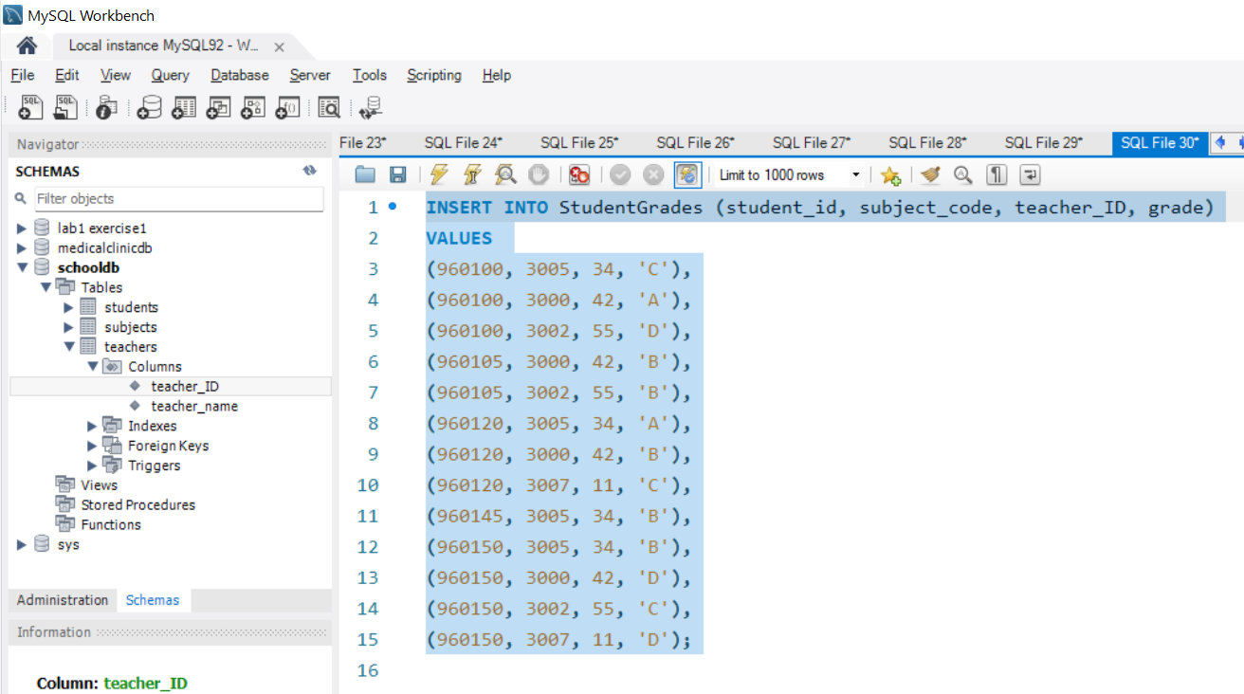
D. Insert Student Grades (Only Relationships)
New Query (+SQL)
Execute it
2 | Faculty of Business and Law | Peter Faber Business School

Slide 48
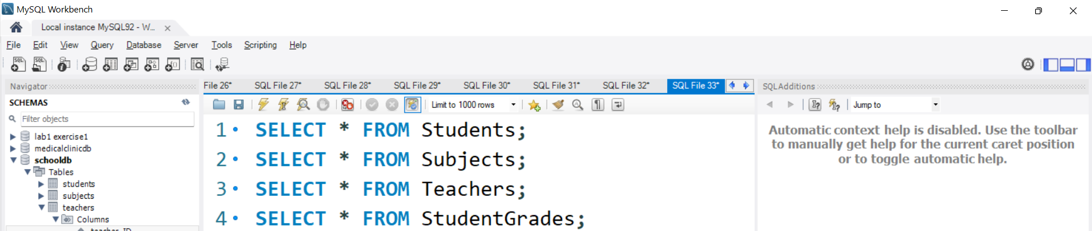
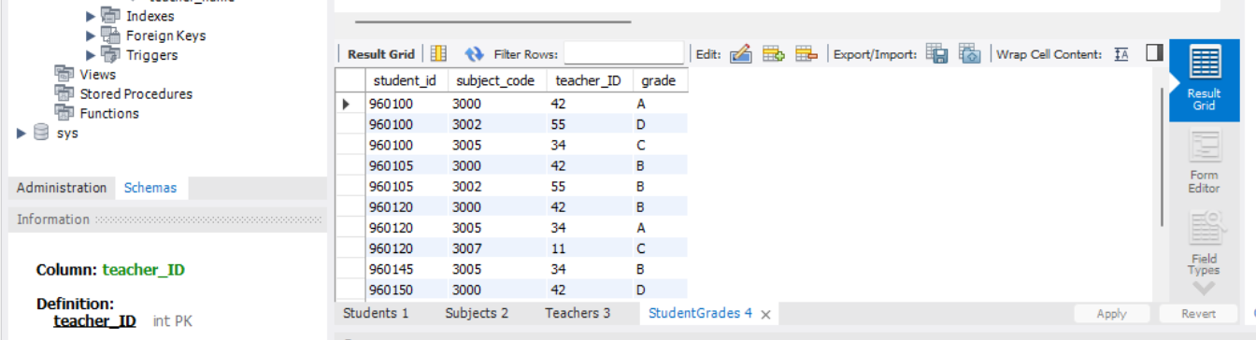
Step 4: Verify the 2NF Structure
Run these queries to check if everything is correctly stored:
2 | Faculty of Business and Law | Peter Faber Business School

Slide 49
Each student appears only once.
Each subject appears only once.
Each teacher appears only once.
The StudentGrades table only contains relationships.
2 | Faculty of Business and Law | Peter Faber Business School

Slide 50
Summary: Why Convert to 2NF?
Your database is now in 2NF!
Problem in 1NF | Fixed in 2NF
Students table contained subject and teacher info | Students table only contains student info
Subjects were repeated multiple times | Subjects stored once in a separate table
Teachers were repeated multiple times | Teachers stored once in a separate table
StudentGrades had partial dependencies | Now each non-key attribute fully depends on the entire primary key
2 | Faculty of Business and Law | Peter Faber Business School

Slide 51
Converting Data from 2NF to 3NF in MySQL
Why Convert to 3NF?
Even though 2NF removes partial dependencies, it may still have transitive dependencies.
2 | Faculty of Business and Law | Peter Faber Business School

Slide 52
Converting Data from 2NF to 3NF in MySQL
3NF Rule:
Must be in 2NF
No Transitive Dependencies:
A transitive dependency occurs when a non-primary key attribute depends on another non-primary key attribute instead of directly depending on the primary key.
2 | Faculty of Business and Law | Peter Faber Business School

Slide 53
Converting Data from 2NF to 3NF in MySQL
Example Problem:
In the StudentGrades table, the teacher_name depends on teacher_ID, not on student_id + subject_code.
This means teacher_name should be moved to the Teachers table.
2 | Faculty of Business and Law | Peter Faber Business School

Slide 54
Step 1: Identify Transitive Dependencies in 2NF
In 2NF, we have
student_id | subject_code | teacher_ID | teacher_name | grade
960100 | 3005 | 34 | B Codd | C
960100 | 3000 | 42 | A Lovelace | A
2 | Faculty of Business and Law | Peter Faber Business School

Slide 55
Step 1: Identify Transitive Dependencies in 2NF
In 2NF, we have
Issues:
teacher_name is dependent on teacher_ID, not student_id + subject_code.
Solution: Move teacher_name to the Teachers table.
Fix: Remove teacher_name from StudentGrades and store it only in the Teachers table.
2 | Faculty of Business and Law | Peter Faber Business School

Slide 56
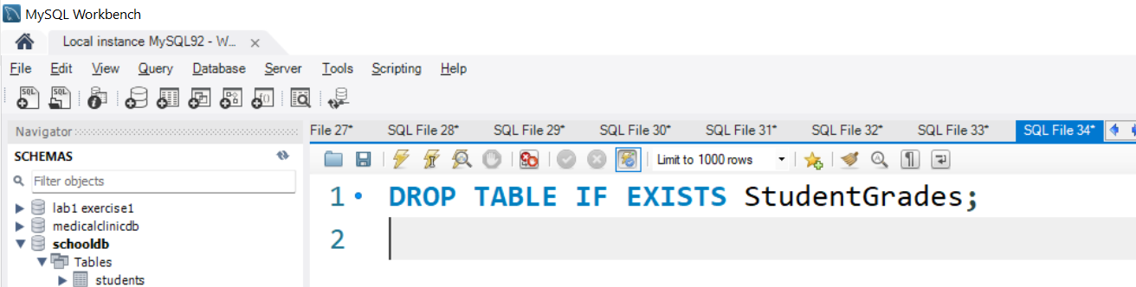
Step 2: Modify the Table Structure for 3NF
To achieve 3NF, we must eliminate transitive dependencies by ensuring that every non-key attribute directly depends on the primary key.
A. Drop the Incorrect StudentGrades Table (if needed)
If your current StudentGrades table contains transitive dependencies, delete it before creating a new one:
2 | Faculty of Business and Law | Peter Faber Business School

Slide 57
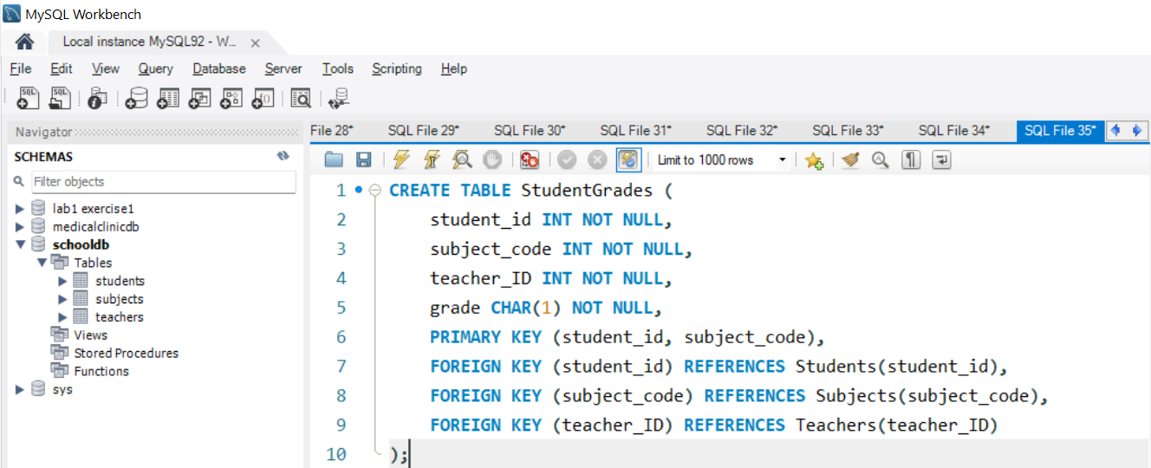
B. Recreate the StudentGrades Table (Without teacher_name)
Now, teacher_name is completely removed and stored only in Teachers.
Why?
No transitive dependencies (every non-primary key column now depends directly on the primary key).
2 | Faculty of Business and Law | Peter Faber Business School

Slide 58
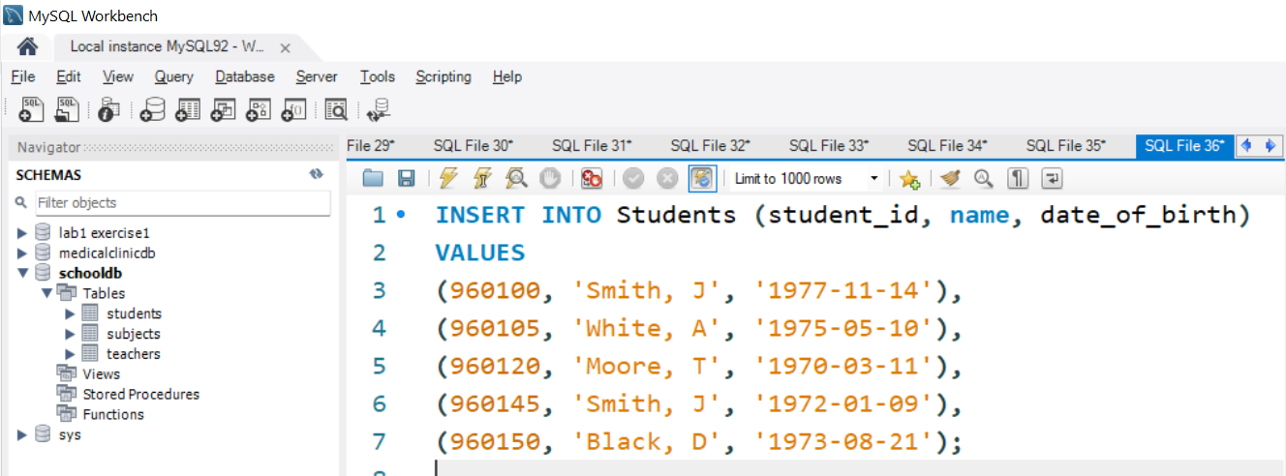
Step 3: Insert 3NF-Compliant Data
Now, insert each entity separately.
A. Insert Students (No Subject or Teacher Info)
2 | Faculty of Business and Law | Peter Faber Business School

Slide 59
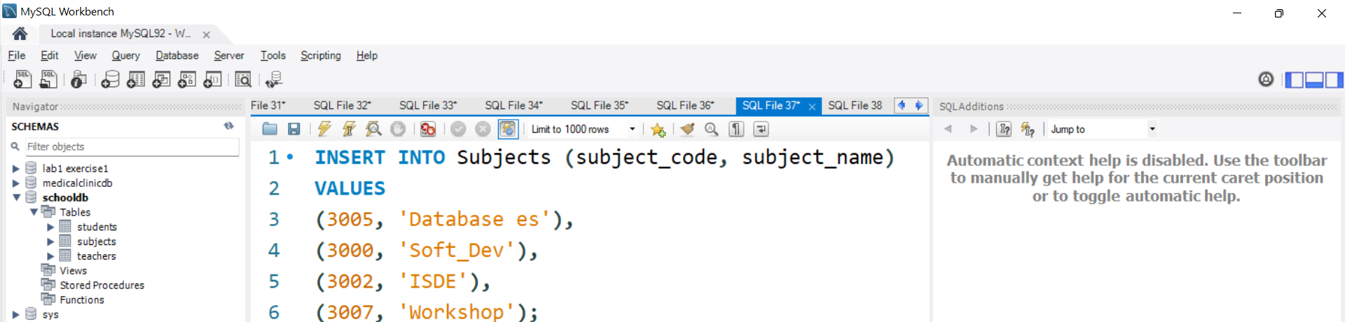
B. Insert Subjects (No Student or Teacher Info)
2 | Faculty of Business and Law | Peter Faber Business School

Slide 60
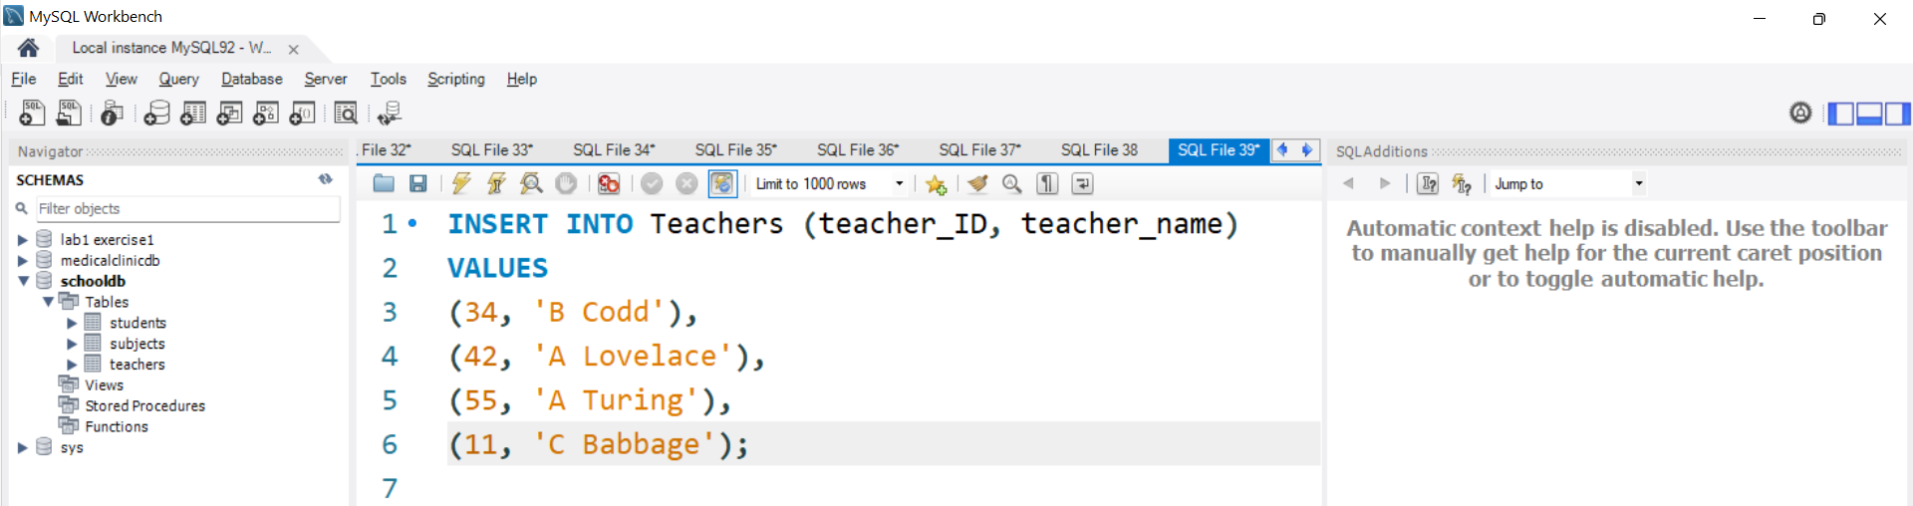
C. Insert Teachers (No Student or Subject Info)
2 | Faculty of Business and Law | Peter Faber Business School

Slide 61
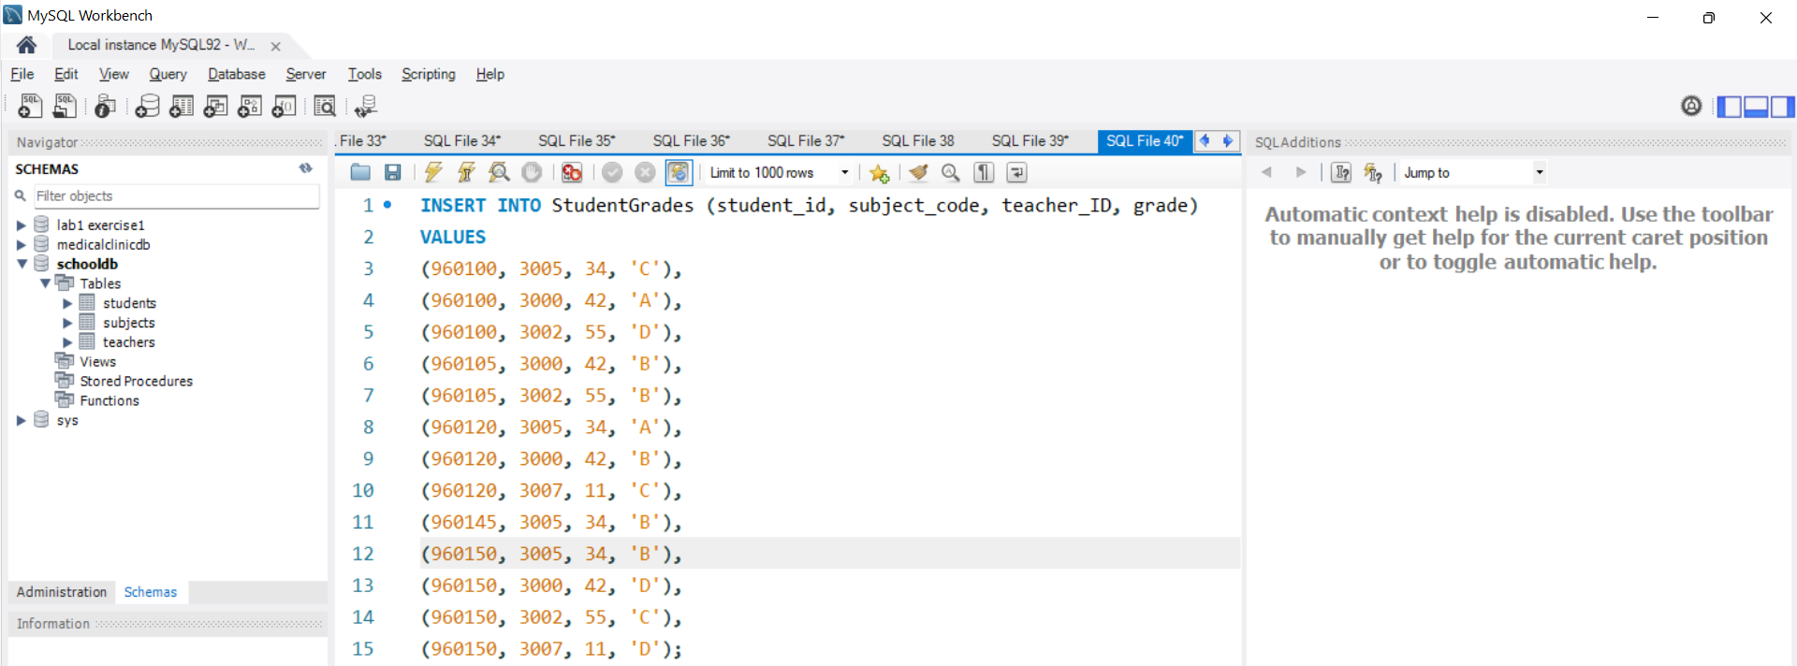
D. Insert Student Grades (Only Relationships, No Teacher Name)
Now, teacher_name is no longer stored here, preventing transitive dependencies.
2 | Faculty of Business and Law | Peter Faber Business School

Slide 62
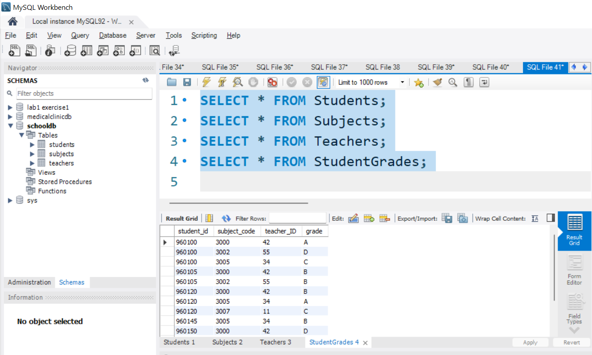
Step 4: Verify the 3NF Structure
Run these queries to check if everything is correctly stored:
2 | Faculty of Business and Law | Peter Faber Business School

Slide 63
Results:
Each table stores only relevant attributes.
No transitive dependencies exist.
2 | Faculty of Business and Law | Peter Faber Business School

Slide 64
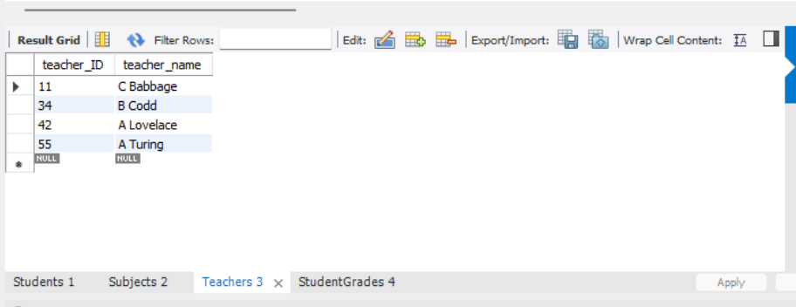
Summary: Why Convert to 3NF?
Your database is now in 3NF!
Problem in 2NF | Fixed in 3NF
teacher_name was stored in StudentGrades | Now stored only in Teachers
Transitive dependency existed (teacher_name depended on teacher_ID) | Now all attributes depend only on the primary key
2 | Faculty of Business and Law | Peter Faber Business School

Slide 65
Submission of Labs & Assessments
These guidelines are designed to support your learning and help you apply necessary techniques effectively. For lab or assessment submissions, please follow instructions and complete tasks based on Canvas. If you have any questions, feel free to ask—I’m happy to help!

Slide 66
Thank You
Have a Great Learning Day!
Feel free to reach out with any questions!
Dr. Farshid Keivanian

